Slide 1
EMPLOYEES PERFORMANCE SCORECARD IN EXCEL
Student name: R.Padmasri
Reg no: 312200922
Department: B.COM(COMPUTER APPLICATION)
College: Pachaiyappa’s college for women, kanchipuram

Slide 2
AGENDA:
PROBLEM STATEMENT
PROJECT OVERVIEW
END USER
OUR SOLUTION AND PROPOSITION
UNDERSTANDING EMPLOYEE PERFORMANCE EVALUATION
PURPOSE OF CONDUCTING PERFORMANCE EVALUATION OF EMPLOYEES
Formulas and functions
conclusion

Slide 3


Slide 4


Slide 5
Problem Statement:
Create an employee performance scorecard in Excel that:
Tracks key performance metrics for each employee
2. Allows for easy data entry and scoring
3. Calculates an overall performance rating
4. Provides a comments section for feedback and action plans
Step-by-Step Guide:
1. Set up the scorecard template:
Create a new Excel spreadsheet and set up the following columns:| Column A | Column B | Column C | Column D | Column E || --- | --- | --- | --- | --- || Metric | Target | Actual | Score | Weightage |

Slide 6
List performance metrics:
In Column A, list the key performance metrics for each employee, such as:- Communication- Leadership- Problem-Solving- Customer Service- Teamwork
Set targets and weights:In Column B, set targets for each metric (e.g., 4.5 for Communication). In Column E, assign a weightage to each metric (e.g., 20% for Communication).
Enter actual performance data:
In Column C, enter the employee's actual performance data for each metric.1. Calculate scores:
In Column D, use a formula to calculate the score for each metric based on the actual performance data and targets.
For example:=IF(C2>=B2,5,IF(C2>=B2_0.8,4,IF(C2>=B2_0.6,3,IF(C2>=B2*0.4,2,1))))

Slide 7
Calculate overall performance rating:
Create a formula to calculate the overall performance rating based on the weighted scores. For example:
=SUM(D2:D6)*E2:E61.
comments section:Create a separate section for comments and action plans.
Format and finalize:Format the scorecard to make it easy to read and use. Finalize the template and save it for future use.
By following these steps, you'll have a comprehensive employee performance scorecard in Excel that helps you track and evaluate employee performance effectively.

Slide 8
Project overview
Objective:
Design and develop a comprehensive employee performance scorecard in Excel to track, measure, and evaluate individual performance. The scorecard will provide a clear and transparent framework for assessing employee strengths, weaknesses, and areas for improvement.
Scope:-
Create a customizable Excel template for employee performance evaluation- Include relevant performance metrics and categories (e.g., communication, leadership, problem-solving, customer service, teamwork)- Develop a scoring system to assess employee performance (e.g., 1-5 rating scale)- Incorporate weighted scores to reflect the importance of each metric- Calculate an overall performance rating- Provide a comments section for feedback and action plans

Slide 9
Deliverables:
Employee Performance Scorecard Excel Template
2. User Guide with instructions for data entry and scoring
3. Sample data and examples for demonstration purposes
Timeline:-
Week 1: Research and planning-
Week 2-3: Design and development of the scorecard template-
Week 4: Testing and iteration-
Week 5: Finalize and deliver the project
Key Stakeholders:- HR Department- Managers and Supervisors- Employees

Slide 10
\
Assumptions and Dependencies:-
Access to Excel software-
Basic knowledge of Excel formulas and functions-
Input from stakeholders on performance metrics and categories
Project Risks:-
Complexity in designing a comprehensive scorecard-
Ensuring accuracy and consistency in scoring-
Potential resistance to change from employees or managers.
By following this project overview, you'll create a valuable tool to support employee performance evaluation and development.

Slide 11
Who are the end users?
Human resource (HR) Managers
Department Managers / supervisiors
Senior Management /Executives
Employees

Slide 12
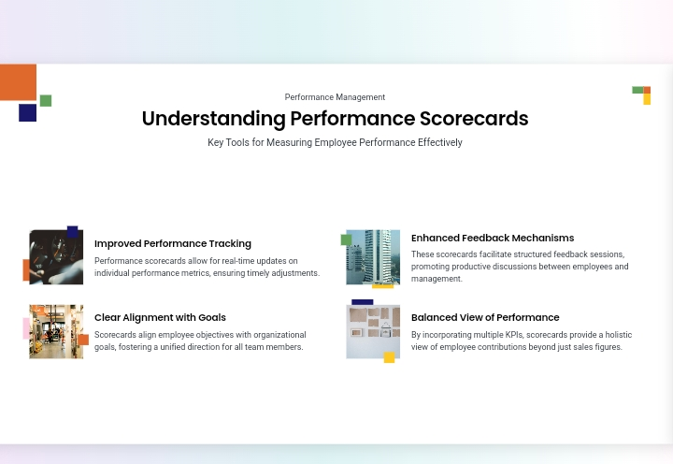

Slide 13
Understanding employee performance evaluation
In Simple terms, employee performance evaluation is an important process that helps business managers and HR Personnel to ensure that employees are performing right and where they can improve.
As an HR professional, you can evaluate employees on a quarterly, half-yearly, or yearly basis.
Opportunities to enhance the efficiency of human resources can only be initiated when the current efficiency level is known.
Furthermore, such performance evaluations give us legal, ethical, and visible evidence of employee performance.
It helps us to know, how actively they are involved, and how much they understand the job requirements.

Slide 14
Purpose of conducting performance evaluation of employees
There are various reasons behind performance evaluation requirement for employees in any organization or industry.
However, to list the general reasons and purpose behind performance evaluation of employees can be –
Performance evaluation helps to understand whether employee’s output is as per the industry norms and standards.
Helps to uplift the productivity of the organization.
Employees can understand about their weaknesses and areas of improvements.
Benefits both employees and employers to have a broad outlook on themselves.
Data can be useful while doing inter and intra department or functional shuffling of employees.
Need of additional trainings and skill development programs can be easily identified.

Slide 15
our Solution and its value propositions:
Section 1: Employee Information| Employee Name | Job Title | Review Period |
| --- | --- | --- |
Section 2: Performance Metrics| Metric | Target | Actual | Score (1-5) | Weightage |
| --- | --- | --- | --- | --- |
| Communication | 4.5 | | | 20% |
| Leadership | 4.2 | | | 25% |
| Problem-Solving | 4.0 | || 20% |
| Customer Service | 4.5 | | | 15% |
| Teamwork | 4.2 | | | 20% |
Section 3: Scoring and Rating| Metric | Score | Weighted Score |
| --- | --- | --- |
| Communication | | =D2_E2 |
| Leadership | | =D3_E3 |
| Problem-Solving | | =D4_E4 ||
Customer Service | | =D5_E5 |
| Teamwork | | =D6*E6 | Overall Rating | | =SUM(G2:G6) |

Slide 16
Formulas and Functions
Scoring formula: =IF(Actual>=Target,5,IF(Actual>=Target_0.8,4,IF(Actual>=Target_0.6,3,IF(Actual>=Target*0.4,2,1))))- Weighted score formula: =Score*Weightage- Overall rating formula: =SUM(Weighted Scores)
Instructions:1. Enter employee information In Section 1.2. Set targets and weightages for each metric in Section 2.3. Enter actual performance data for each metric.4. Scores will be calculated automatically based on the actual data.5. Enter comments and action plans in Section 4.
This template provides a comprehensive framework for evaluating employee performance. Customize it to fit your organization's specific needs and performance metrics.

Slide 17
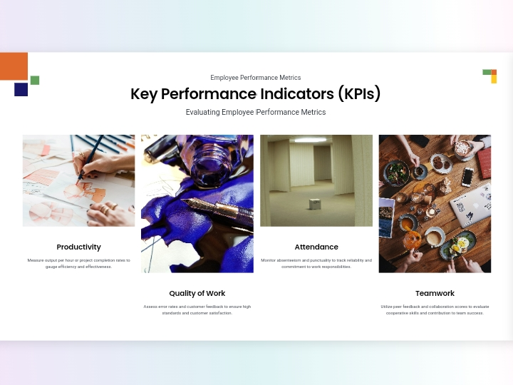

Slide 18


Slide 19
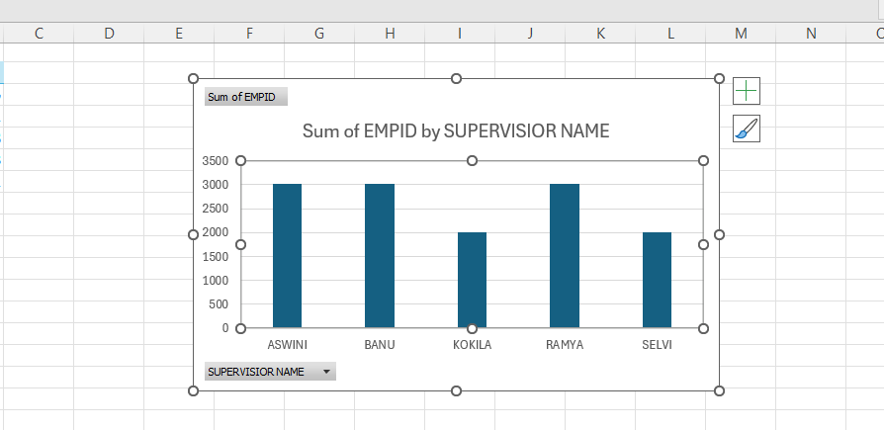
RESULT:

Slide 20


Slide 21


Slide 22
Conclusion:
An employee performance scorecard in Excel provides a practical and versatile approach to performance management.
By creating a structured and customizable scorecard, organizations can effectively track, evaluate, and improve employee performance.
Despite its limitations, Excel remains a valuable tool for many businesses, offering a cost-effective solution for performance management.
As organizations evolve, they may need to explore more advanced systems, but Excel’s accessibility and flexibility make it a strong starting point for performance evaluation.

